Slide 1
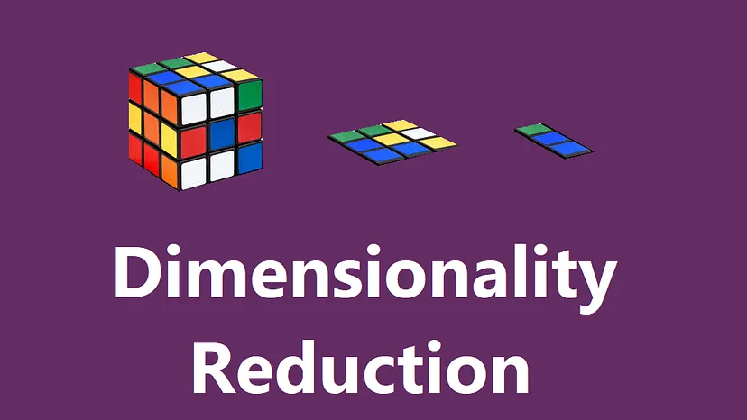
1
3

Slide 2
Dimensionality Reduction ?
Reducing dimensions from higher to lower.
Notes:
Dimensionality reduction is the process of reducing dimensions from higher to lower. Dataset with higher dimensions are reduced to lower dimensions. But why dimension needs to be reduced?

Slide 3
Dimensionality Reduction ?
Reducing dimensions from higher to lower.
But why dimension needs to be reduced ?

Slide 4
Dimensionality Reduction ?
Reducing dimensions from higher to lower.
But why dimension needs to be reduced ?
To reduce complexity of model
To prevent overfitting
For better visualization

Slide 5
Dimensionality Reduction ?
Reducing dimensions from higher to lower.
But why dimension needs to be reduced ?
To reduce complexity of model
To prevent overfitting
For better visualization
So, how to select important features ?

Slide 6
Dimensionality Reduction ?
Reducing dimensions from higher to lower.
But why dimension needs to be reduced ?
To reduce complexity of model
To prevent overfitting
For better visualization
So, how to select important features ?
Filter Method
Calculates correlation coefficient score of each features and select based on score.
Wrapper Method
Predictive model is used to evaluate a combination of features and assign a score based on model accuracy
Embedded Method
Learn which features best contribute to the accuracy of the model

Slide 7
Dimensionality Reduction ?
Reducing dimensions from higher to lower.
But why dimension needs to be reduced ?
To reduce complexity of model
To prevent overfitting
For better visualization
So, how to select important features ?
Filter Method
Calculates correlation coefficient score of each features and select based on score.
Wrapper Method
Predictive model is used to evaluate a combination of features and assign a score based on model accuracy
Embedded Method
Learn which features best contribute to the accuracy of the model
So, what are the techniques of Dimensionality reduction ?

Slide 8
Dimensionality Reduction Technique’s
PCA (Principal Component Analysis )
LDA ( Linear Discriminant Analysis )
TSNE ( T-distributed Stochastic Neighbor Embedding )
UMAP ( Uniform Manifold Approximation and Projection )
SVD ( Singular Value Decomposition )

Slide 9
Principal Component Analysis

Slide 10
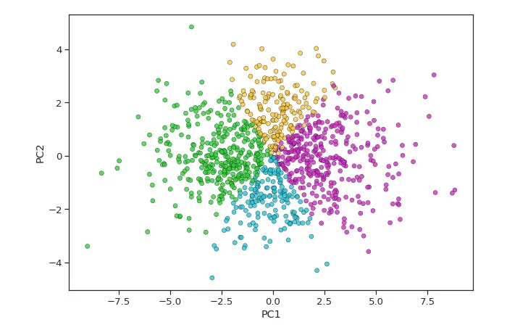
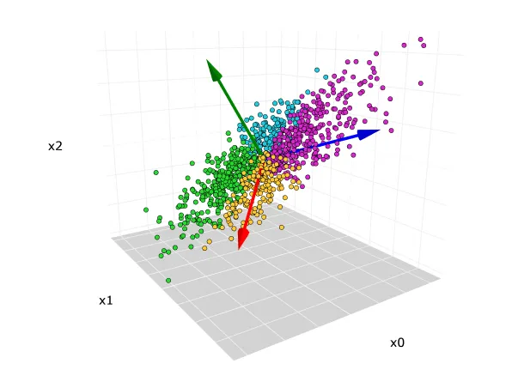
Principal Component Analysis
PCA reduces higher dimensional data into lower dimensional space by identifying a set of new uncorrelated variable called principal components.
Principal Components are determined by computing eigenvectors of the covariance matrix.

Slide 11
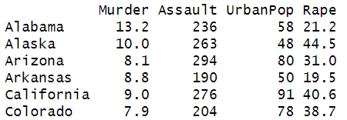
Principal Component Analysis
PCA reduces higher dimensional data into lower dimensional space by identifying a set of new uncorrelated variable called principal components.
Principal Components are determined by computing eigenvectors of the covariance matrix.
Let’s Perform PCA using “US Arrests” dataset on R

Slide 12
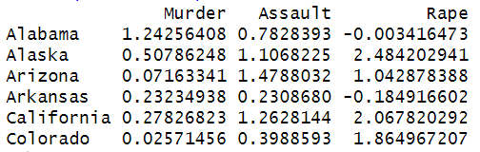
Principal Component Analysis
PCA reduces higher dimensional data into lower dimensional space by identifying a set of new uncorrelated variable called principal components.
Principal Components are determined by computing eigenvectors of the covariance matrix.
Let’s Perform PCA using “US Arrests” dataset on R
Data Normalization: Scale each of the variables to have a mean of 0 and a standard deviation of 1.

Slide 13
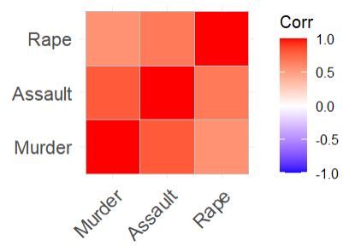
2. Calculate the correlation matrix for the scaled variables.

Slide 14
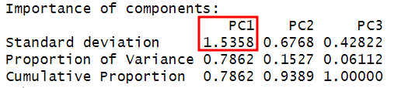
2. Calculate the correlation matrix for the scaled variables.
3. Selection of Principal Components
We select PC1 to be retained as the Eigenvalue (SD) is >=1
So, we use PC1 as the “criminality score” to represent 3 features using PCA method

Slide 15
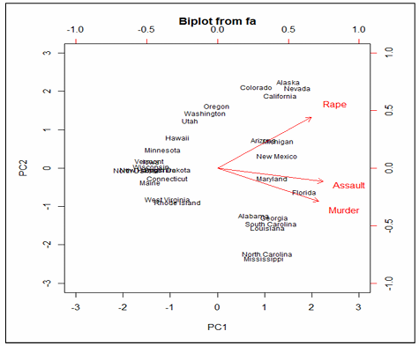
2. Calculate the correlation matrix for the scaled variables.
3. Selection of Principal Components
We select PC1 to be retained as the Eigenvalue (SD) is >=1
So, we use PC1 as the “criminality score” to represent 3 features using PCA method

Slide 16
THANK YOU

